Slide 1

Mockpie
“presentation helper tool”
Supervised by
DR. Muhammed El-Ramly

Slide 2

Our team
Noor eyad eissa
Ahmed Muhammed Abdelaziz
Jana wael ibrahim elgendy
karim khaled mustafa
mariam haitham mohamed

Slide 3


01
Motivation and background
TABLE OF CONTENTS
02
Problem significance
03
related work
04
Project Specifications
05
Technologies and Application
06
MODEL SPECIFICATIONS
07
Conclusion

Slide 4

01.
Motivation and background

Slide 5
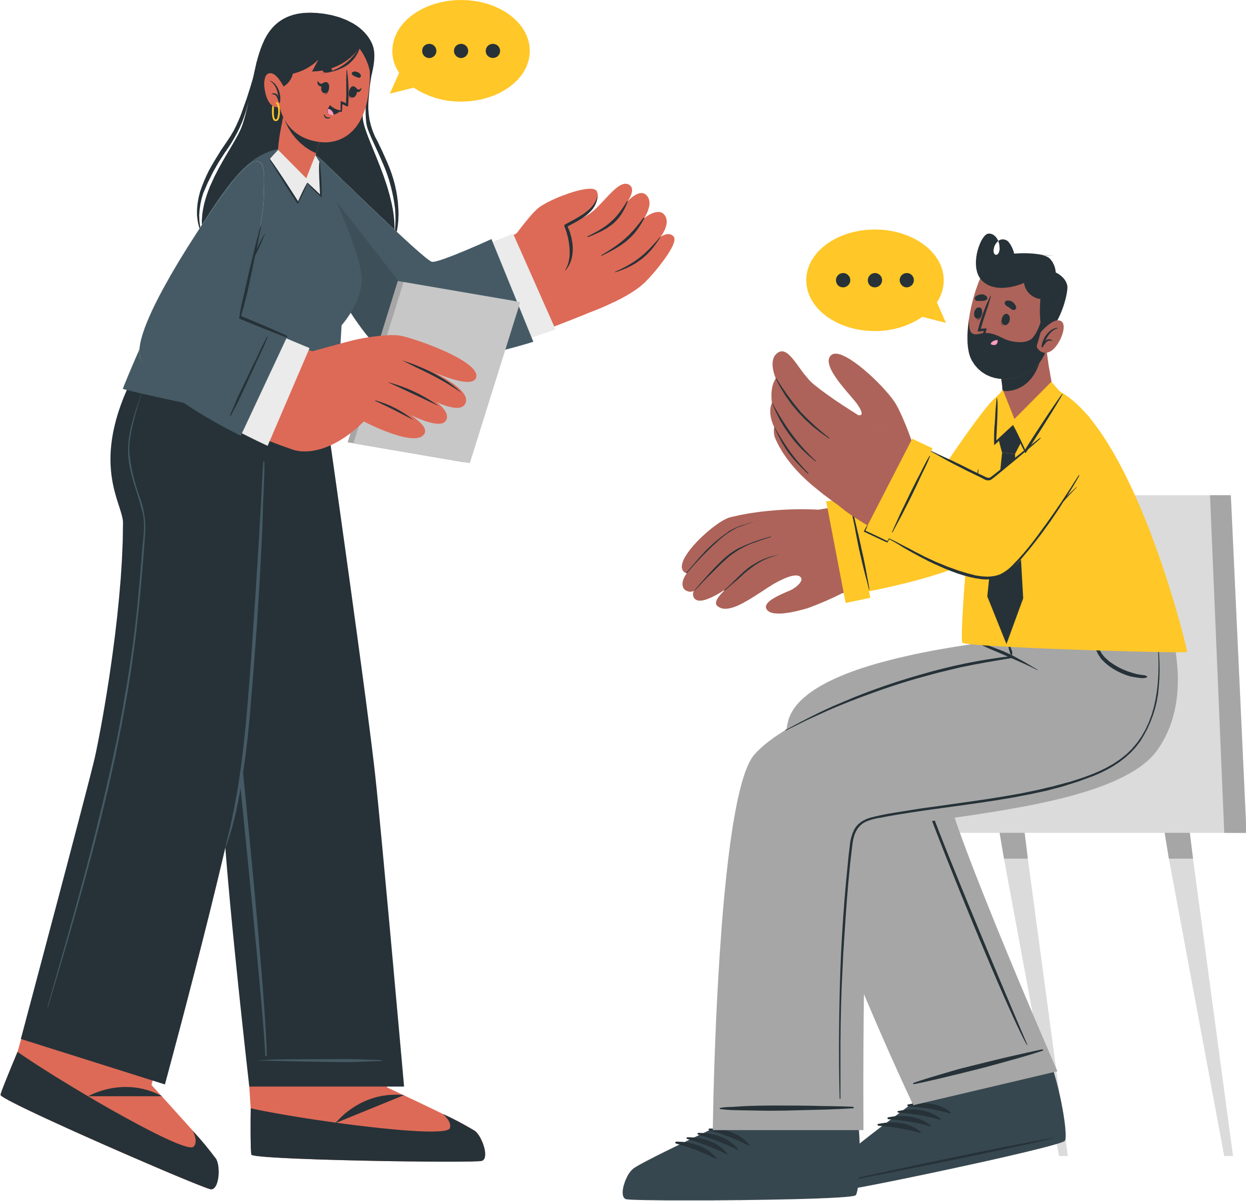
Motivation
Everybody gets nervous when it’s public speaking time.
Enhance your presentation skills with ease.
Get instant feedback on mistakes—no stress, no embarrassment.
Accessible anytime, anywhere—just need an internet connection!

Slide 6

Background
AI-powered presentation helper with real-time, personalized feedback.
Analyzes tone, pace, clarity, posture, and gestures.
Users upload videos to receive actionable insights.
Delivers feedback through intuitive visualizations.

Slide 7

02.
Problem significance

Slide 8

Problem Significance
Strong presentation skills are essential in professional and academic settings.
Common challenges include nervousness, poor body language, and unclear speech.
Many struggle due to a lack of awareness and feedback.

Slide 9
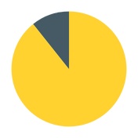
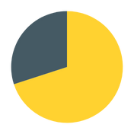
EXAMPLES
References:
Toastmasters International.
LinkedIn Learning.
National Institute of Mental Health (NIMH).
85%
70%
60%
85%
of students feel that improving presentation skills would boost their academic performance and confidence.
difficulty of receiving objective and actionable feedback on their voice tone and body language.
experience Glossophobia before giving a presentation or public speech.
expressed a desire for classes to improve public speaking.

Slide 10
Main Idea and application
Machine learning for voice and video analysis.
NLP and speech recognition assess tone, speech disruptions, and pace.
Computer vision techniques, including pose detection and gesture recognition

Slide 11

03.
related work

Slide 12
Related work
Vosaic
VoiceVibes
analyzes videos by segmenting them and providing detailed feedback on performance.
analyzes speech patterns to provide feedback on tone, clarity, and engagement.
Orai
Speeko
provides AI-powered speech analysis to help users improve their public speaking skills.
uses AI-driven voice analysis to help users improve their speaking skills.

Slide 13


Comparison
Feature | Mockpie | Vosaic | Orai | VoiceVibes | Speeko
AI Speech Analysis
Body Language Analysis
Feedback Video Segmentation
Share Feedback

Slide 14
04.
Project
specifications

Slide 15
Stakeholders
01
02
03
Public-speakers
Developers
AI Engineers
04
05
06
Testers
Organizations
Educators/Trainers

Slide 16
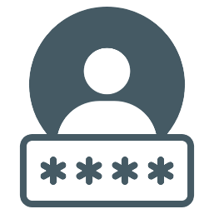







Functional requirements
Registration / Login
Users can create an account and log in
Video Upload / Record
Users can upload pre-recorded videos or record directly through the system
Video Analysis
uploaded/recorded videos analyzed to evaluate voice tone, and body language.
Calendar View
Users can view their presentation schedule and progress in a calendar format.
Feedback Analysis
The system analyzes presentations and provides detailed feedback on voice tone, and body language.
Share Feedback
Users can share their feedback reports with others via email or a shareable link.
View Presentation History
Users can view a list of their past presentations and access previous feedback reports.
Delete Submitted Trials
Users can delete their uploaded/recorded presentations and associated feedback from the system.

Slide 17






non-Functional requirements
System Responsiveness
Video Processing Speed
User Interface Simplicity
Data Encryption
Authentication
Scalability

Slide 18
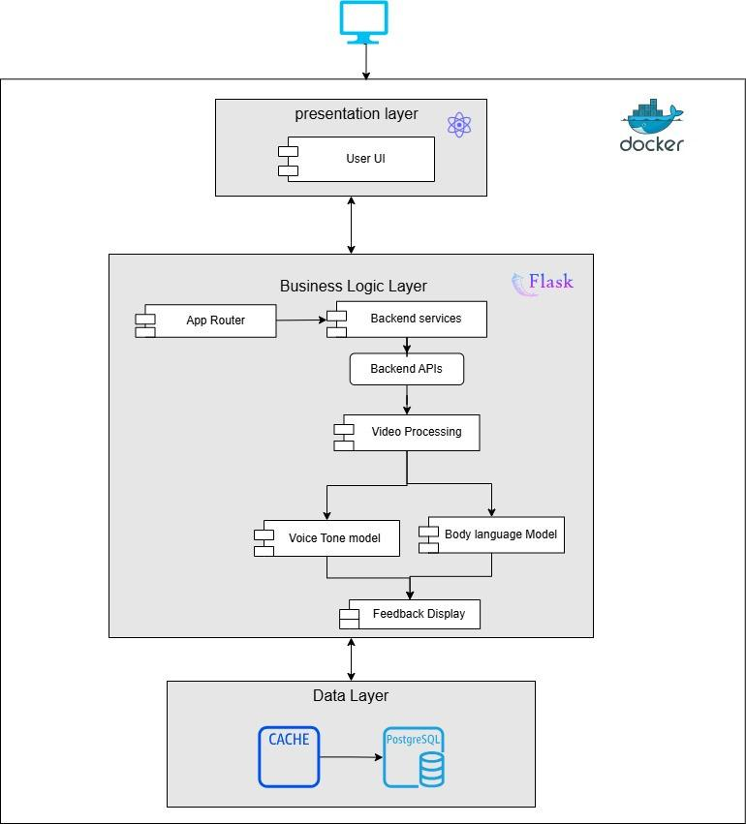
System architecture
Layers:
Presentation​ Layer
Business​ Logic Layer
Data Layer ​
Why?​
Ease of development​
Reduced dependency​
Testing is easier ​

Slide 19
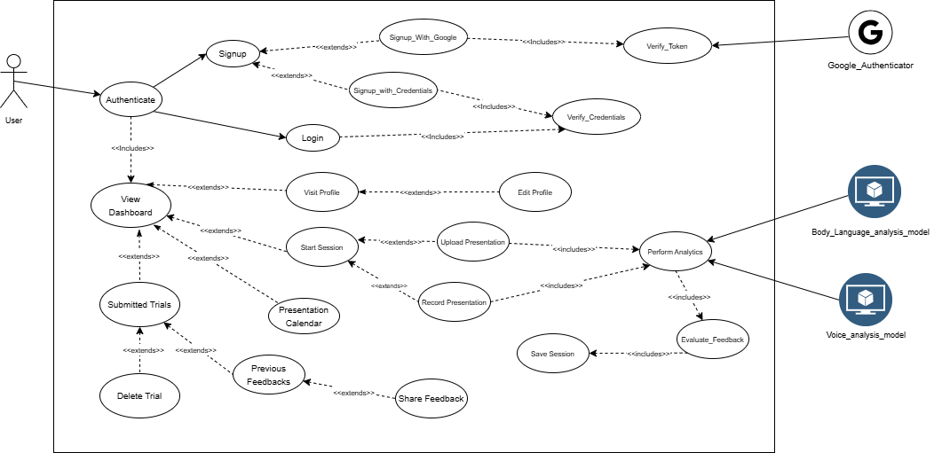
Use case diagram

Slide 20
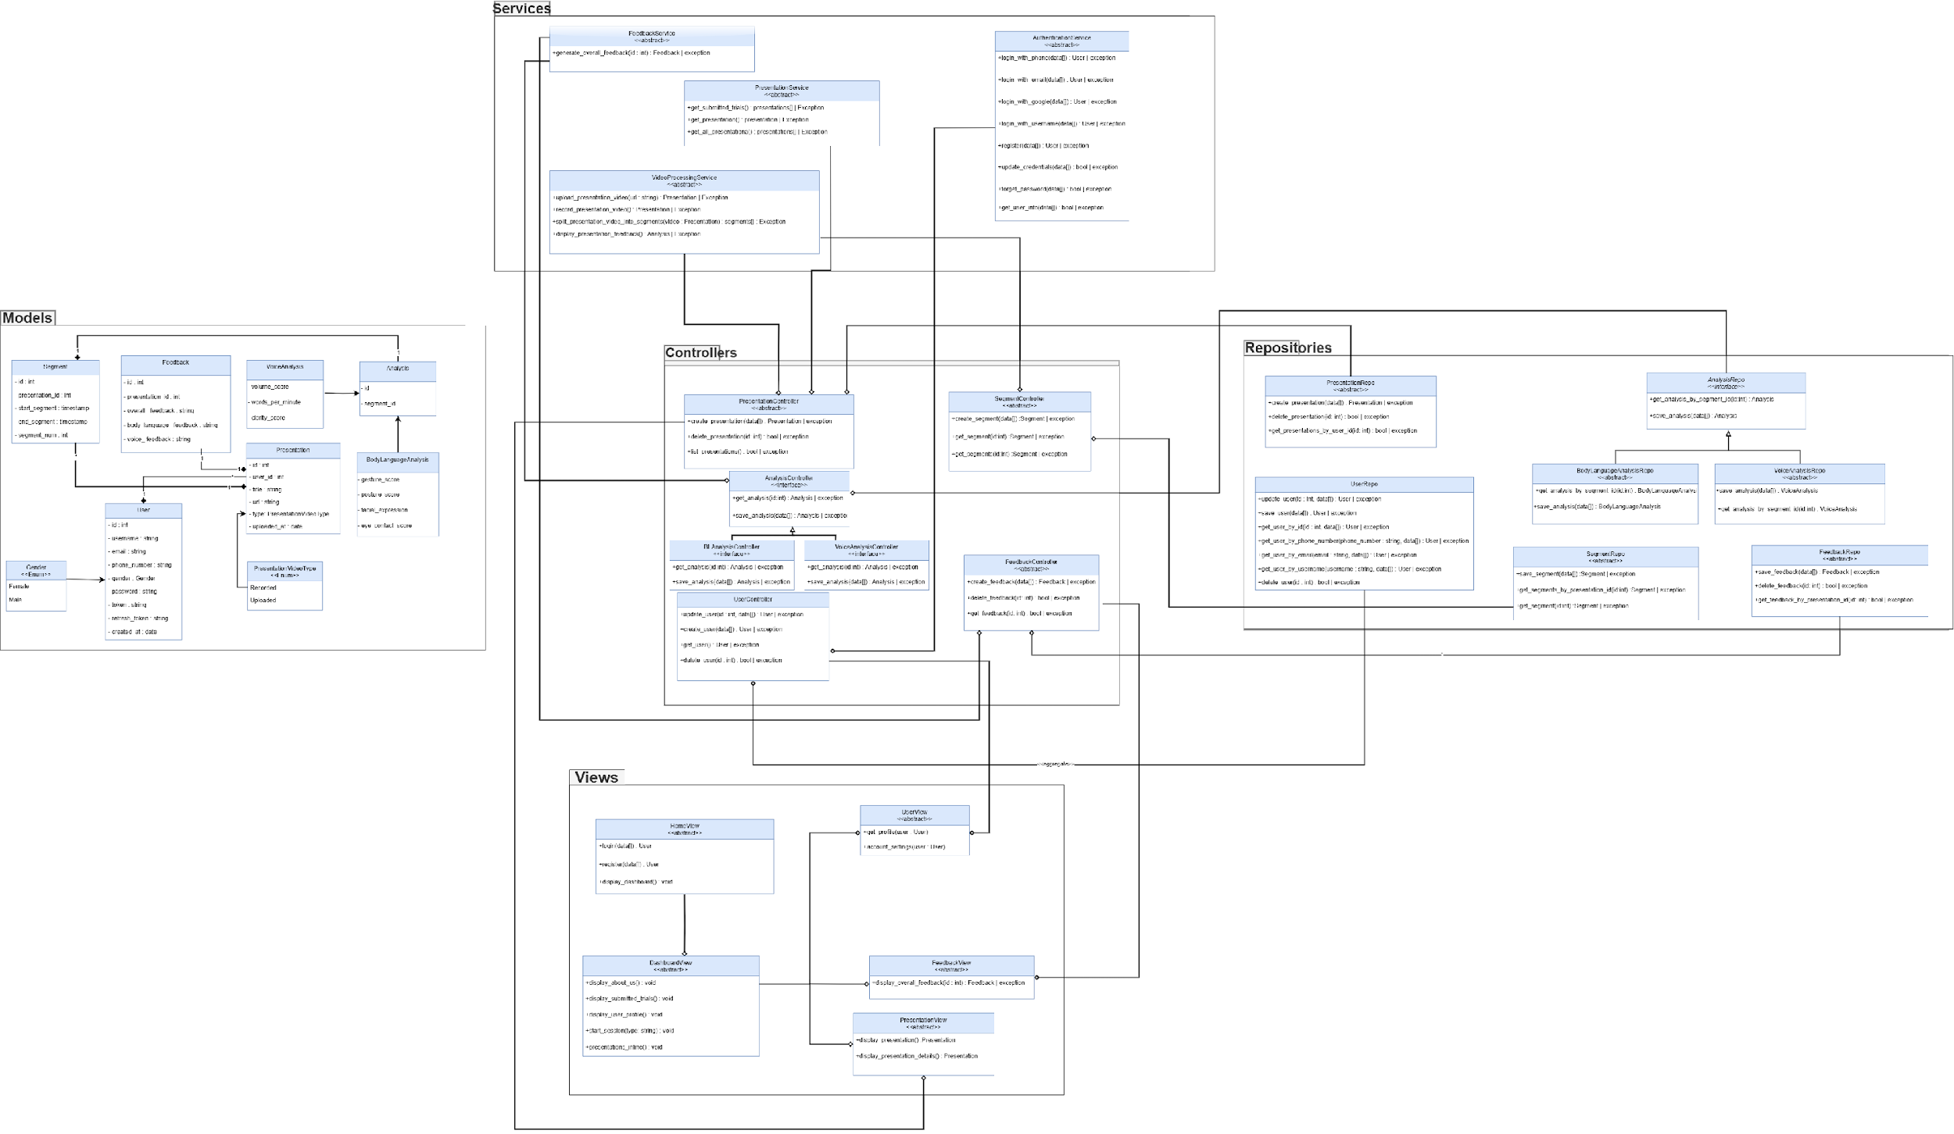
Class diagram

Slide 21
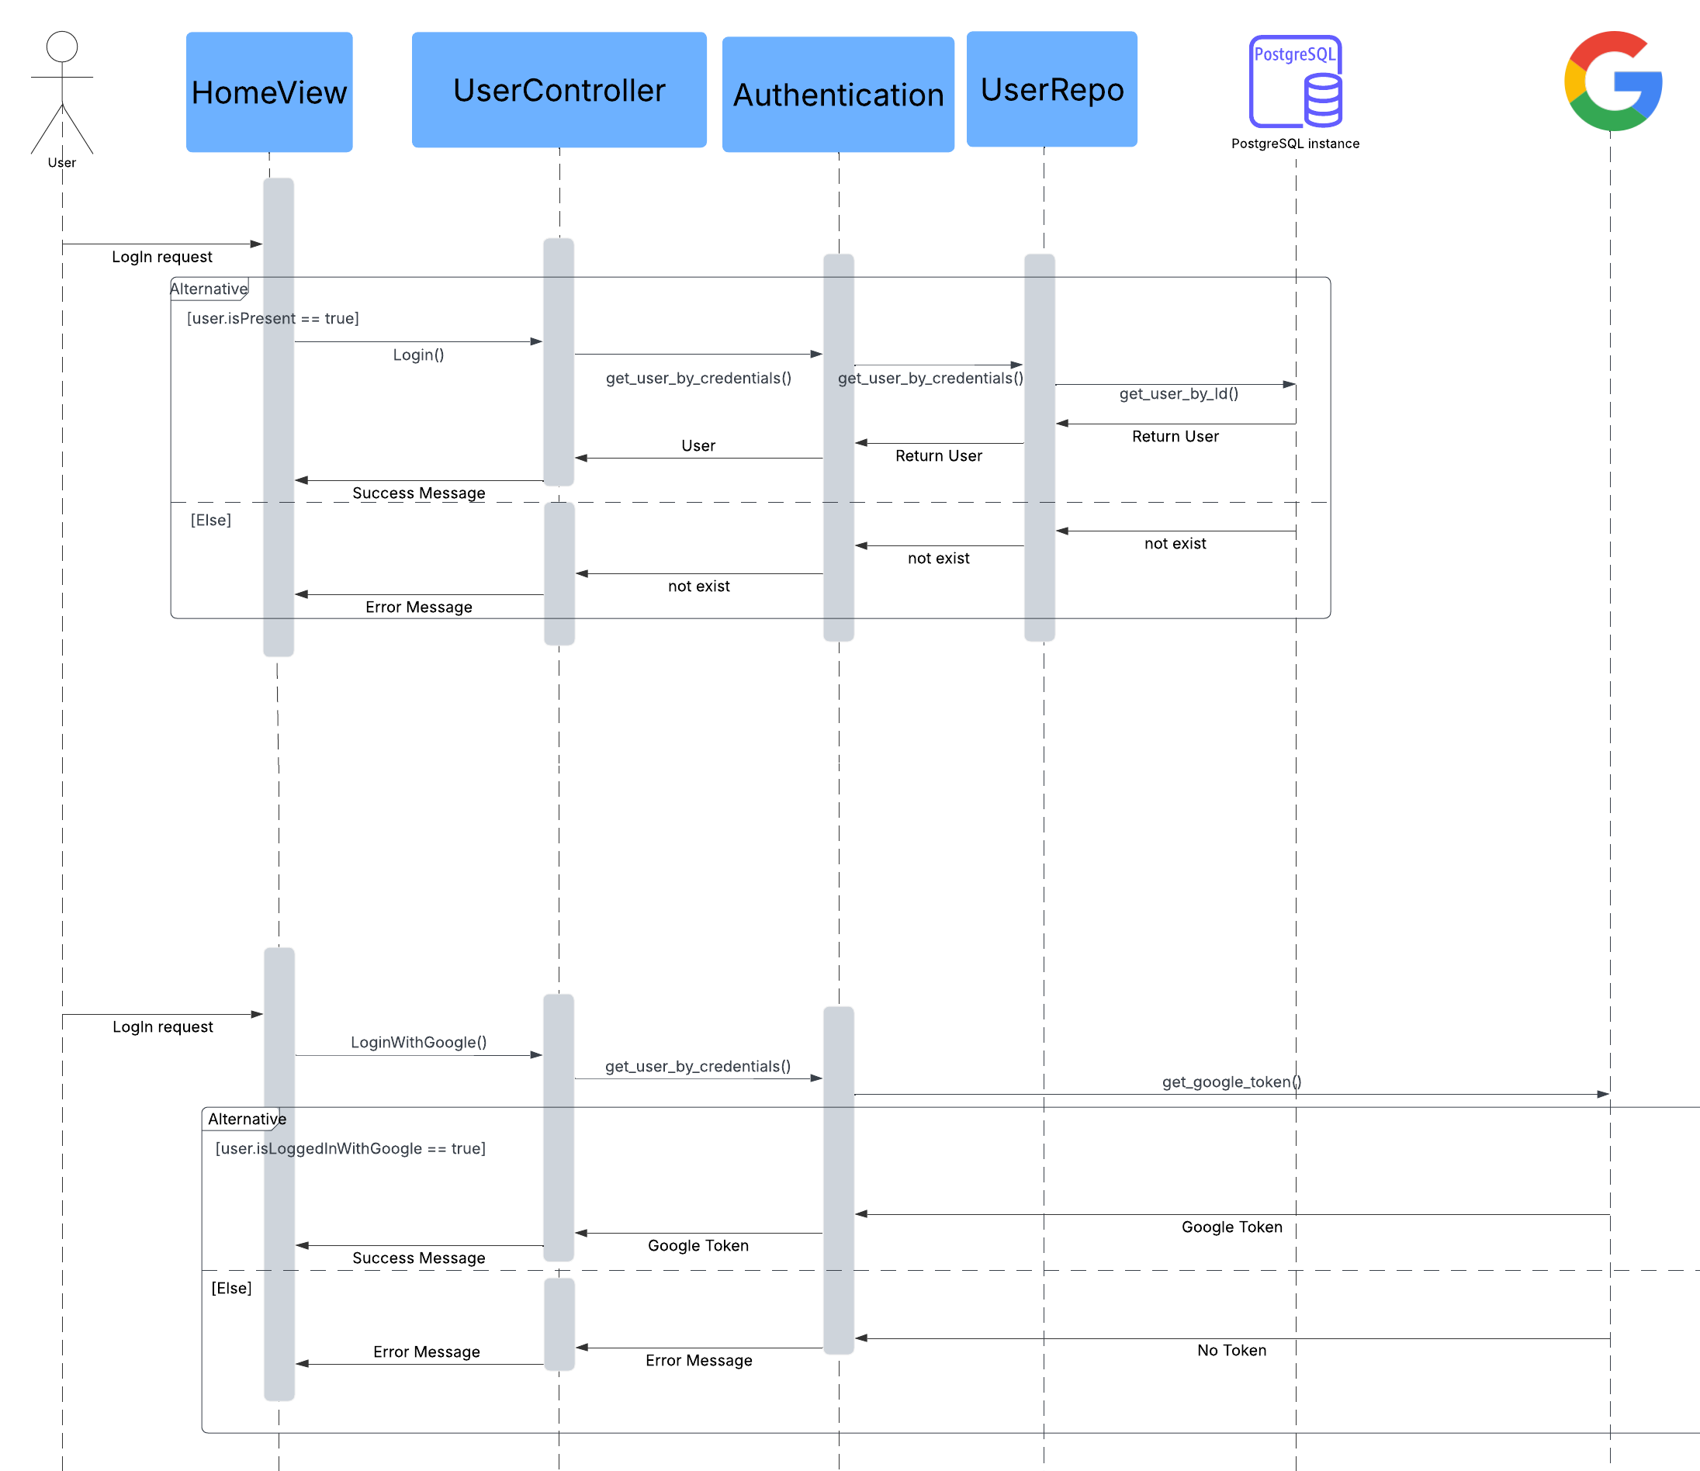
authentication Sequence diagram

Slide 22
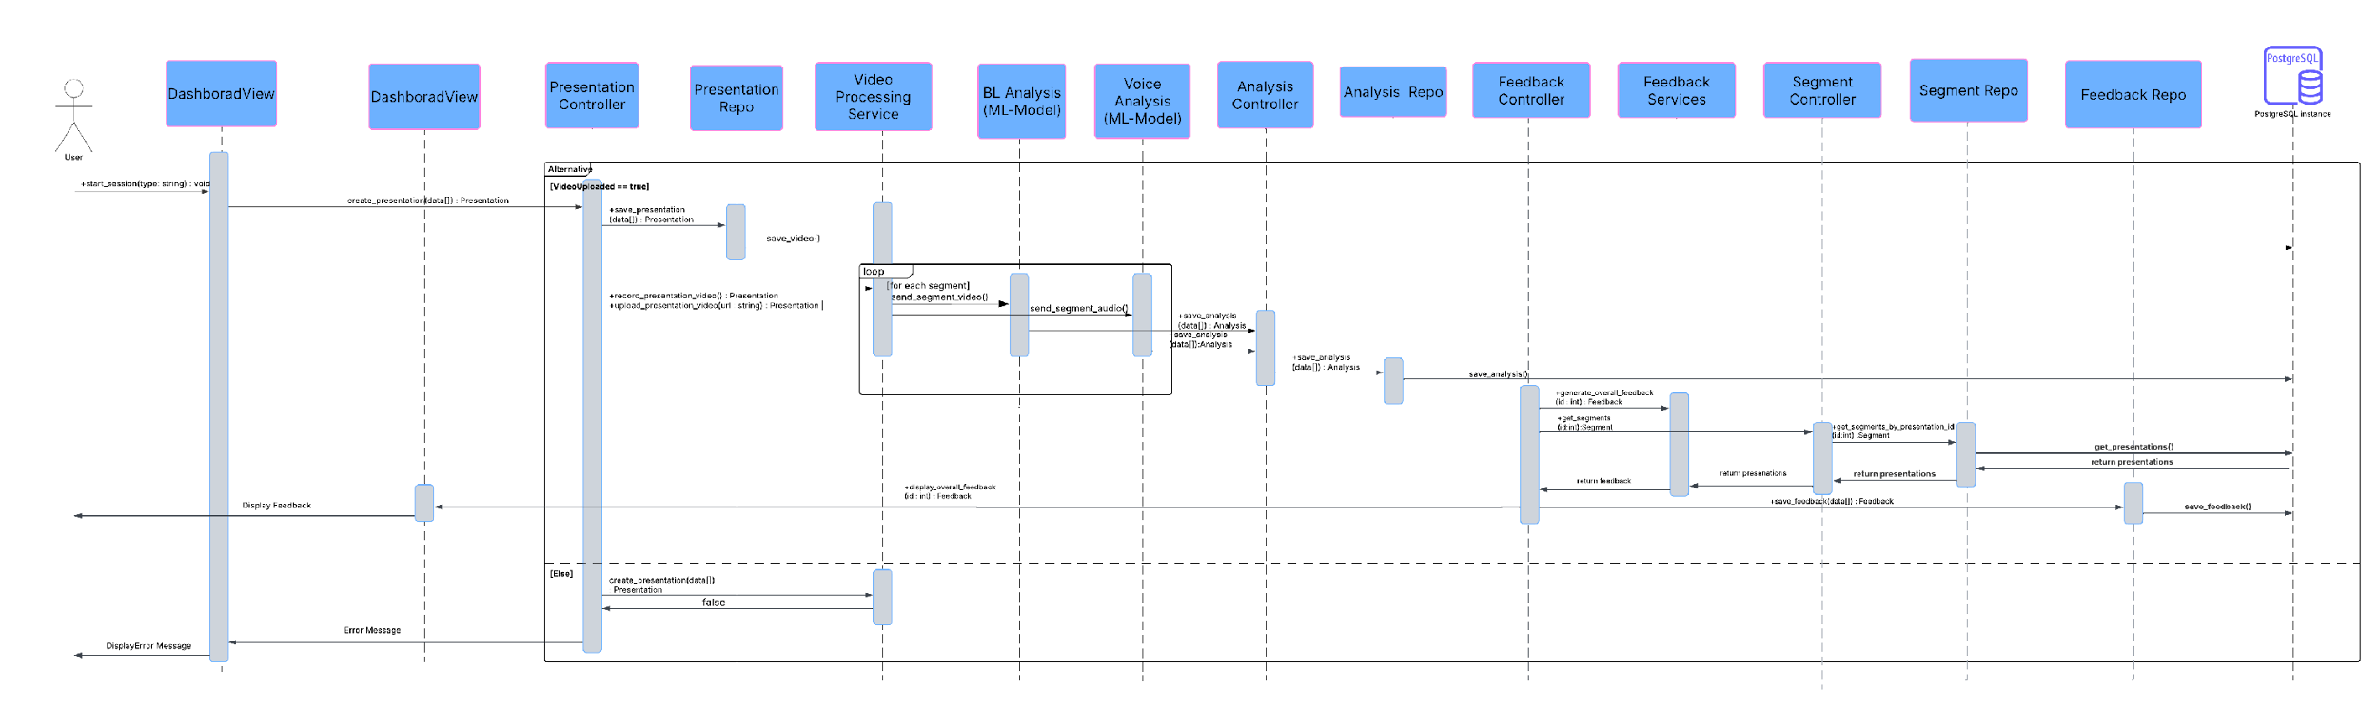
feedback sequence diagram

Slide 23
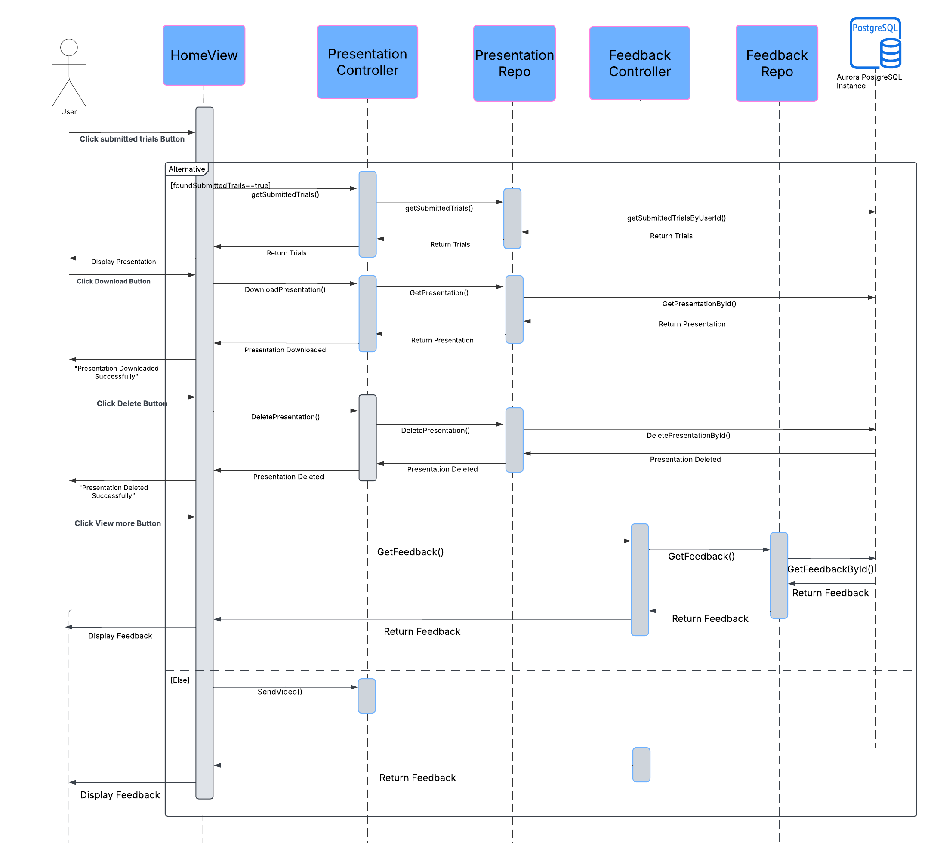
Submitted trials Sequence diagram

Slide 24
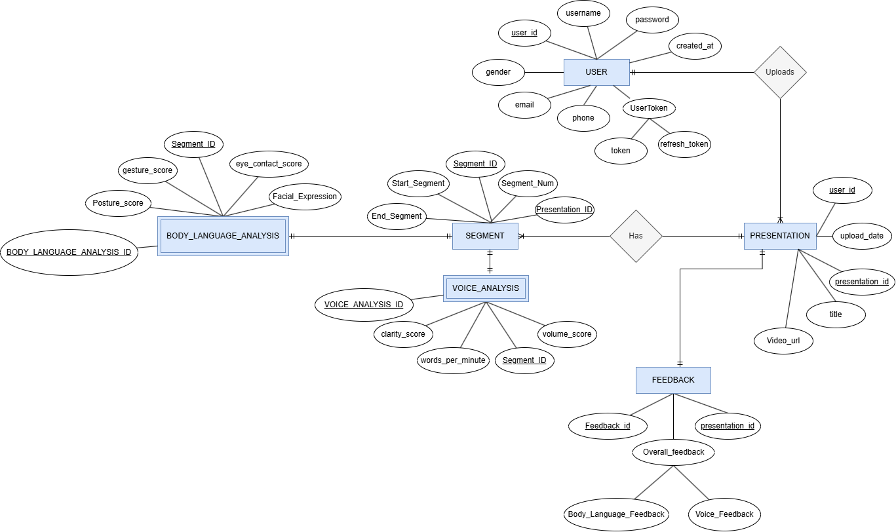
Entity-Relationship Diagram

Slide 25
05.
Technologies and Application

Slide 26





Flask
Redis
A Python web framework used to build web applications and APIs.
Provides flexibility and simplicity, making it ideal for microservices and rapid development.
An in-memory key-value database known for high-speed caching.
Supports data structures like lists, sets, and hashes, making it useful for real-time applications.
Docker
A platform that allows applications to be packaged in isolated containers.
Ensures consistency across different environments, making deployment easier and more efficient.
REAct native
PostgreSQL
A JavaScript library for building fast and interactive user interfaces.
Uses a component-based architecture, making UI development modular and reusable.
A powerful open-source relational database known for reliability and scalability.
Supports advanced features like JSON storage, full-text search, and concurrency control.

Slide 27

06.
ML Model specificATIONS

Slide 28
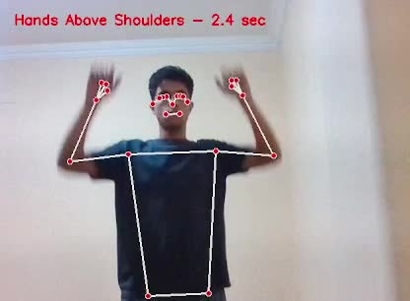
BODY LANGUAGE ML MODEL
After searching among different posture detections ml models, we chose Mediapipe instead of OpenPose and DeepLabCut.
Mediapipe detects body posture.
Posture data is analyzed to identify bad postures.
If incorrect, feedback is provided issues and penalties.
Consulted Dr. Dalia Rasmy (Specialized in public speaking at ITI), who stated that 75% of presentation engagement is influenced by body language.

Slide 29
Voice Analysis
Assessing Vocal Nervousness based on:
Voice Tone: Variations in pitch, intensity, and steadiness that indicate nervousness.
Speech Disruptions: Includes stutters such as sudden pauses, prolongations, and repetitions.
Speed: High wpm would indicate that the presenter is nervous.

Slide 30
Voice tone model
Numerous emotion recognition datasets exist.
Using them in a logistic regression model can determine if a user is nervous.
Those datasets include:
RAVDESS: Ryerson Audio-Visual Database of Emotional Speech [1440 params]
SAVEE : Surrey Audio-Visual Expressed Emotion [480 params]
TESS : Toronto Emotional Speech Set [2800 params]
CREMA-D : Crowd Sourced Emotional Multimodal Actors Dataset [7442 params]
Total: [12162 params]

Slide 31
Speech disruptions Analysis
Distilhubert stutter detection
captures stutters:
repetition
blocks and pauses
prolongation
trained on 23.5 million parameters
accuracy reaches 0.9 for stutter classification
(Deployed on Hugging Face)

Slide 32
Speech speed Analysis
Assessing speech speed based on:
Speech Transcription Process:
Use Wit.ai to transcribe the presenter's speech.
Convert the speech into text format for analysis.
Suitable WPM for Public Speaking
Presentations & Public Speaking: 130–160 WPM (clear and effective).

Slide 33
07.
UI/UX Flow

Slide 34
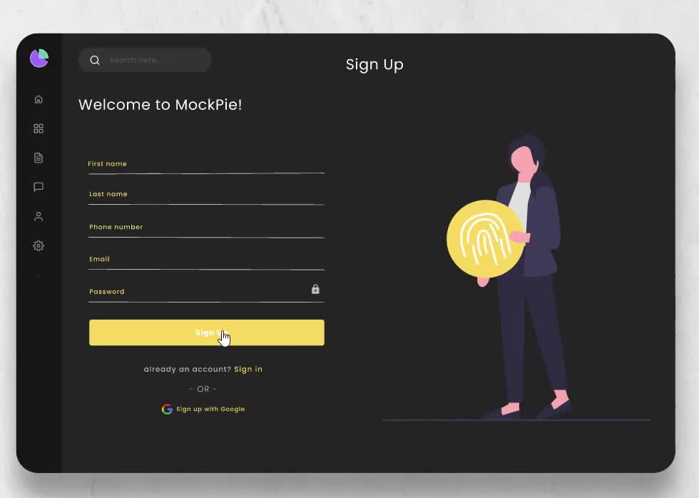
demo
This video presents the UI flow of our project.

Slide 35
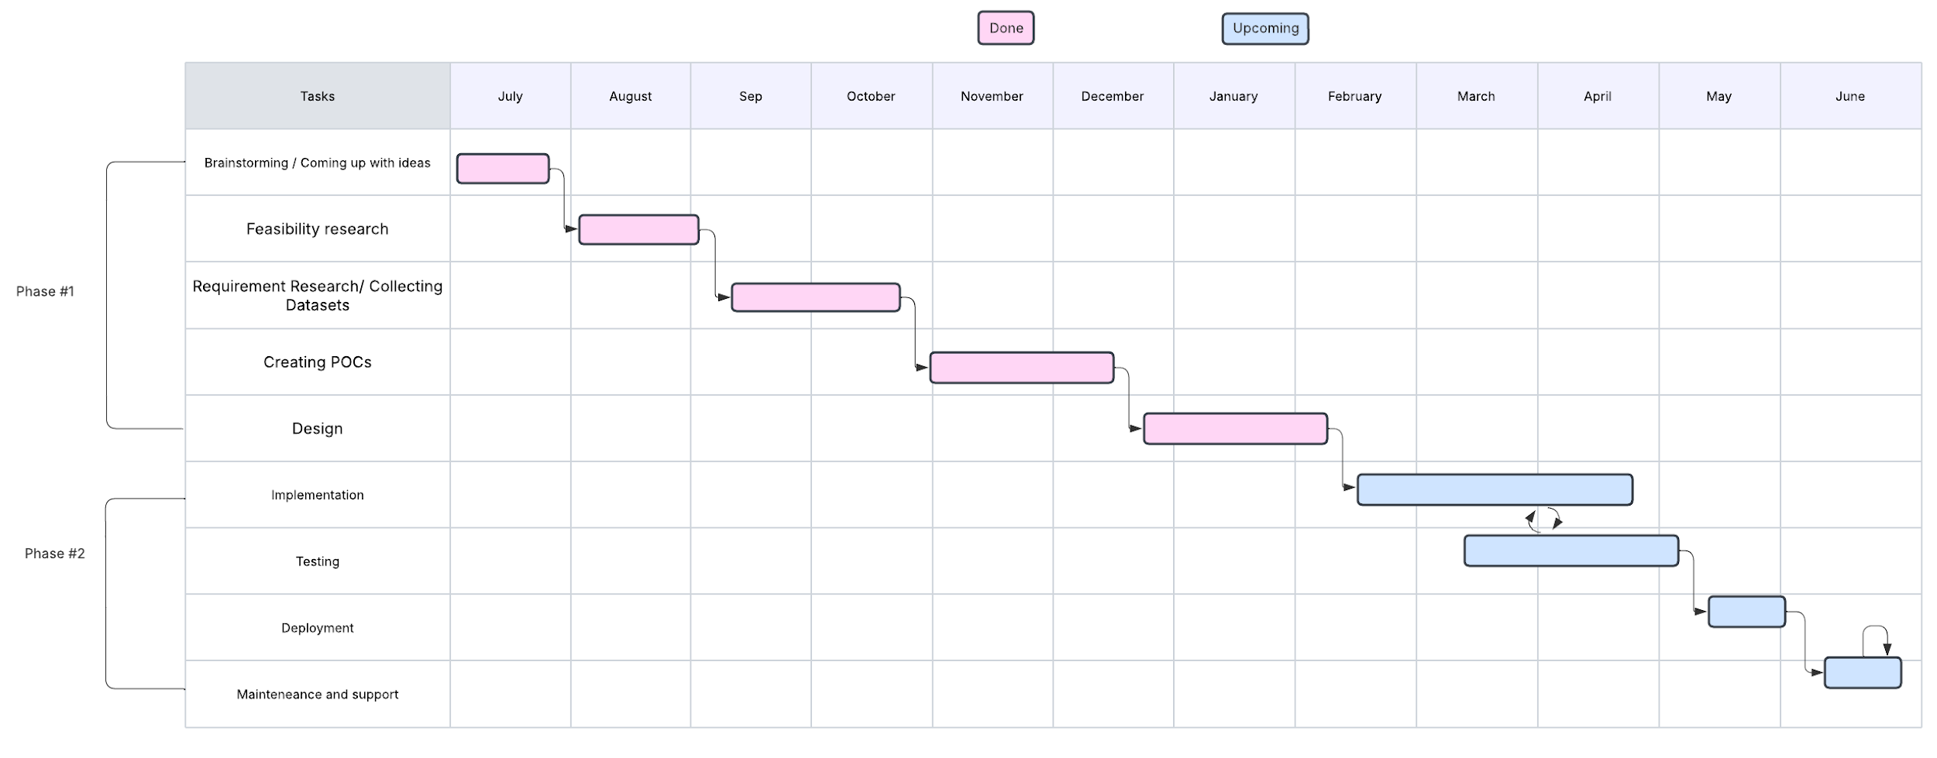
Work plan

Slide 36

THANKS!
Does anyone have any questions?

